Slide 1
Psychology’s contextual origin and Indigenous Psychology
Psych 1a
Dr Eden Thain

Slide 2
Structure of the Module
Lecture 1
What is Cross Cultural Psychology?
Importance of Culture
Culture, Race, Ethnicity
Lecture 2
Multiculturalism
Multiculturalism, Race, and Identity
Cultural Competence
Cultural Adaptation
Lecture 3
Measuring the similarities and differences between Cultures and their effects
Therapy and Mental Illness
Lecture 4
Indigenous Psychology
Role of Psychologist working with Indigenous Australians
Lecture 5
Indigenous Research
Indigenous Research Ethics

Slide 3
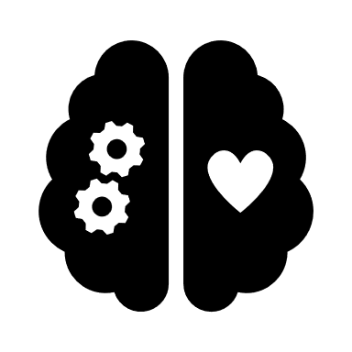

Origins of ‘Psychology’ / Western Psychology
Largely originating from the medical sciences
Long history of focusing on the origin of behaviour as internal
Problem or ‘deficit focus’ means finding issues in people
Focus on the individual and on talking
The above could be said to be indigenous itself
Now is the default / mainstream / accepted (normal)
Indigenous Psychology often means ‘Non-Western’ or divergent from western ‘normal’
Ψ

Slide 4
Why are some considered “psychology” or “other”
Claims that maintain “psychology”
Limitations
Scientific
Objective
“A-political”
Value-free
Progress focused
The above things are all imposed values are perspectives
Lack of reliability (consistency in measurement)
Lack of validity (measure what we aim to measure)
Lack of replicability (being able to repeat findings)
A-Political usually means ignoring the political ramification (of which there are always some)
Deficit and problem focused
Victim blaming (individualist, masculine, short-term - neoliberal)

Slide 5
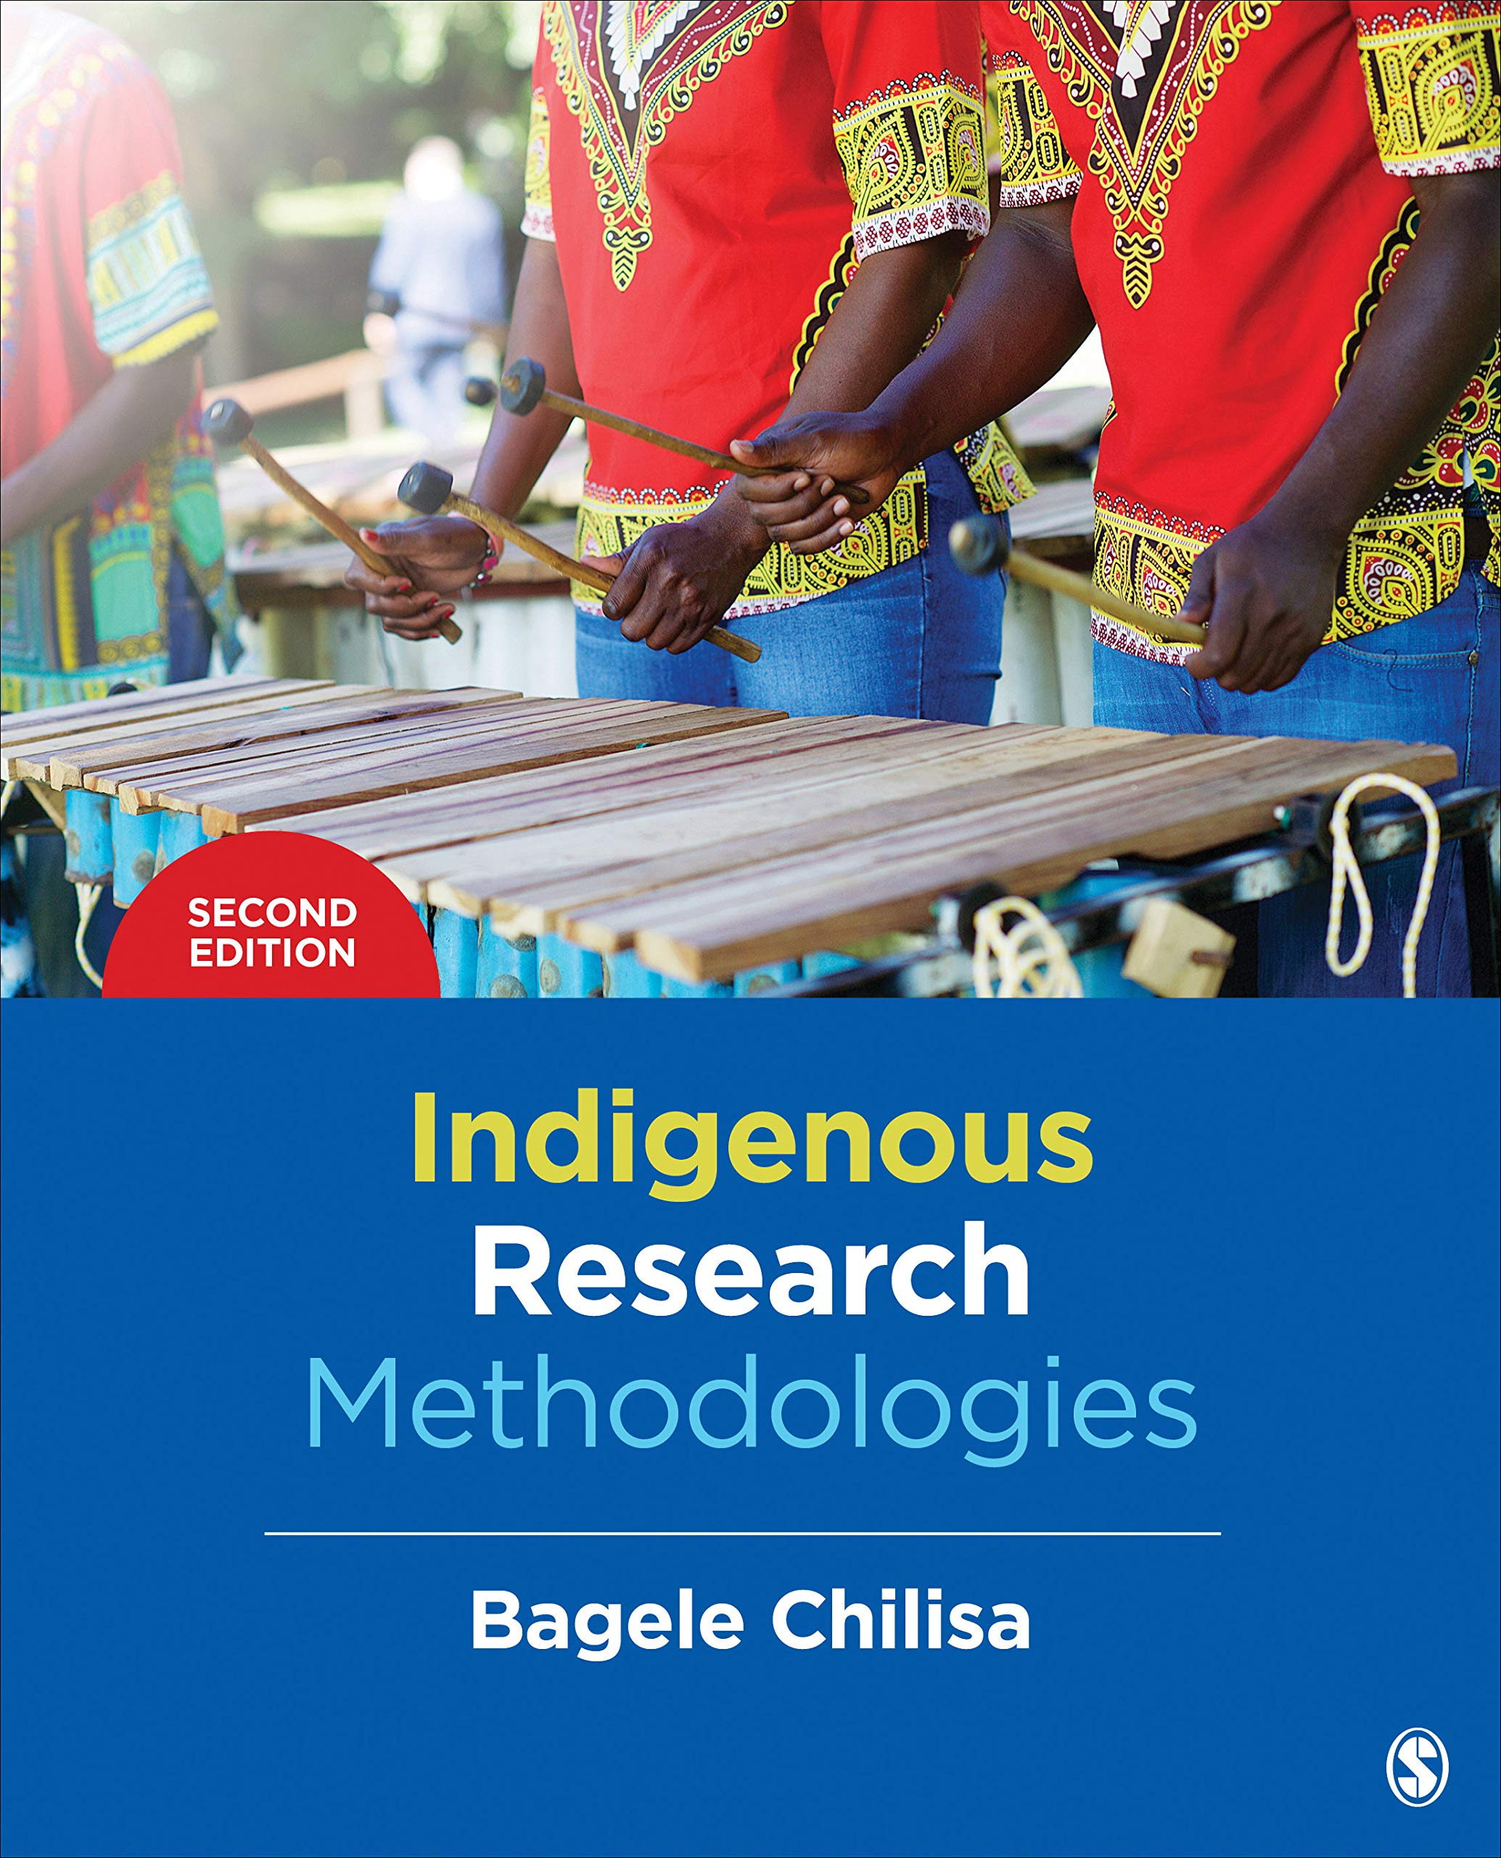
Indigenous Psychology
Emerging area with growing interest and importance
Opposes the universalism that psychology often assumes
Asks questions of things that seem similar (stays critical)
Takes into account context, lived experience and the ‘local reality’
Often requires different methodologies
Aims to produces psychological knowledge that is contextually not universally relevant

Slide 6
Example of Indigenous knowledge

Slide 7
Example of Indigenous Validation

Slide 8
Example of Indigenous Research

Slide 9
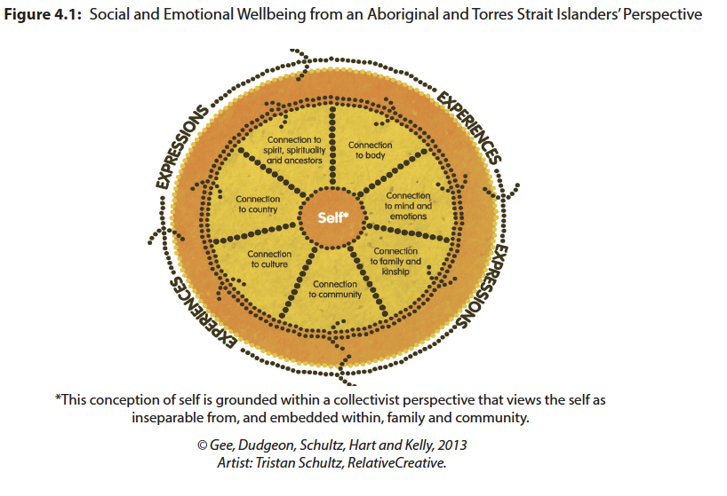
Indigenous knowledge as a source of understanding Social and Emotional Wellbeing (SEWB Model)
The acknowledgement and learning from other ways of knowing including Indigenous knowledge
Connection to many aspects of life outside the individual (individualist–western perspective)
Highlights the effects and recognises the importance of political and cultural differences experienced Aboriginal and Torres Strait Islander Peoples

Slide 10
Wellbeing and Mental Health
… mental health, which is conceptualized as a state of well-being in which the individual realizes his or her own abilities, can cope with the normal stresses of life, can work productively and fruitfully, and is able to make a contribution to his or her community. With respect to children, an emphasis is placed on the developmental aspects, for instance, having a positive sense of identity, the ability to manage thoughts, emotions, as well as to build social relationships, and the aptitude to learn and to acquire an education, ultimately enabling their full active participation in society.
WHO (2013, p. 6)

Slide 11
Issues pertinent in Indigenous Psychology (Dudgeon & Kelly, 2014)
The importance of Land, Kin and Community
Moderate and mediate stressful life events
Source of resilience and recovery in face of prolonged adversity
Restoring or strengthening these connections
Can reduce distress and prevent development of psychological problems
Intergenerational Trauma
Can lead to a sense of powerlessness and loss of control
Profound sense of loss, grief and disconnection
Intergenerational trauma
a phenomenon in which the descendants of a person who has experienced a terrifying event show adverse emotional and behavioral reactions to the event that are similar to those of the person himself or herself. These reactions vary by generation but often include shame, increased anxiety and guilt, a heightened sense of vulnerability and helplessness, low self-esteem, depression, suicidality, substance abuse, dissociation, hypervigilance, intrusive thoughts, difficulty with relationships and attachment to others, difficulty in regulating aggression, and extreme reactivity to stress.
APA Online Dictionary

Slide 12
Reflection
What do you miss when you lose something or someone integral to your person?
What can you do to fill the void once it is gone or broken?
What do you think others can do to help with this and these feelings?
How long do you think it takes for this to stop being a problem?

Slide 13
WAYs forward
Self-determination and community governance
The process or result of engaging in behaviors without interference or undue influence from other people or external demands. Self-determination refers particularly to behaviors that improve one’s circumstances, including decision making, problem solving, self-management, self-instruction, and self-advocacy.
(APA Online Dictionary)
Reconnection and community life
Restoration and community resilience
Reclamation – place, people, land, processes
Professional expectations
Recognition of history of colonisation
Recognition of cultural difference
Need for Aboriginal and Torres Strait Islander peoples to determine culturally appropriate approaches
Current approaches (Western)
Can be useful in some situations
But must be grounded in an Indigenous base
Must be incorporated at appropriate stages
Must be incorporated with care

Slide 14
Your role as a Psy-professional
Developing skills and knowledge
A journey (like cultural competence)
Note your first reactions and feelings
Vulnerability and fear of doing the wrong thing
Incredulity
Sadness or anger
Development can be a bit like ‘culture shock’
Disorientation and anxiety that occurs as people from one culture encounter and adapt to the practices, rules and expectations of another culture
Doesn’t always involve movement or travel of any sort
Transitions between roles or duties in the area
Always seek feedback

Slide 15
Reflection
What else do you need to experience to understand Indigenous Peoples’ experiences, particular those more locally of Aboriginal Australian and Torres Strait Islander Peoples?
Who can you turn to in order to get feedback?
What can you commit to or practice to develop your Cultural Competence regarding Indigenous Populations of the world?

Slide 16
References
America Psychological Association. (2021). Intergenerational Trauma. Retrieved in November 2021 from: https://dictionary.apa.org/intergenerational-trauma
America Psychological Association. (2021). Self-Determination. Retrieved in November 2021 from: https://dictionary.apa.org/self-determination
Chilisa, B. (2019). Indigenous research methodologies (2nd ed). SAGE Publications. ISBN: 9781483333472
Gee, G., Dudgeon, P., Schultz, C., Hart, A., & Kelly, K. (2014). Aboriginal and Torres Strait Islander Social and Emotional Wellbeing. In P. Dudgeon, H. Milroy, & R. Walker (Eds.), Working Together: Aboriginal and Torres Strait Islander Mental Health and Wellbeing Principles and Practice (2nd ed., pp. 55-58). Commonwealth Government of Australia. https://www.telethonkids.org.au/globalassets/media/documents/aboriginal-health/working-together-second-edition/wt-part-1-chapt-4-final.pdf
Murrup-Stewart, Whyman, T., Jobson, L., & Adams, K. (2021). Understanding culture: the voices of urban Aboriginal young people. Journal of Youth Studies, 24(10), 1308–1325. https://doi.org/10.1080/13676261.2020.1828844
Reser, Simmons, M., Johns, E., Ghaly, A., Quayle, M., Dordevic, A. L., Tare, M., McArdle, A., Willems, J., & Yunkaporta, T. (2021). Australian Aboriginal techniques for memorization: Translation into a medical and allied health education setting. PloS One, 16(5), e0251710–e0251710. https://doi.org/10.1371/journal.pone.0251710
Toombs, Nasir, B., Kisely, S., Ranmuthugala, G., Gill, N. S., Beccaria, G., Hayman, N., Kondalsamy-Chennakesavan, S. N., & Nicholson, G. C. (2019). Cultural validation of the structured clinical interview for diagnostic and statistical manual of mental disorders in Indigenous Australians. Australasian Psychiatry : Bulletin of the Royal Australian and New Zealand College of Psychiatrists, 27(4), 362–365. https://doi.org/10.1177/1039856219852289
World Health Organization. (‎2013)‎. Mental health action plan 2013-2020. World Health Organization. https://apps.who.int/iris/handle/10665/89966

